Slide 1
Module II
Process Framework Models: Capability maturity model (CMM), ISO 9000.
Phases in Software development –
  requirement analysis
    requirements elicitation(Intelligent information) for software, analysis principles, software prototyping, specification.

Slide 2
Module II
CS308 Software Engineering and Project Management
Arunvinodh C
AP, CSE

Slide 3
Phases in Software development
Requirement analysis - Module 2
Planning phase - Module 3
Coding phase - Module 4
Maintenance phase - Module 5
Project scheduling and tracking - Module 6

Slide 4
Requirement analysis
Related to the analysis of the system boundaries and the system characteristics.
The requirements analysis/engineering involves
  requirements elicitation,
  documentation and
  maintenance of the requirements.
Requirements engineering is a repeatable and systematic technique.
In each and every phase of the requirements engineering lifecycle, the requirements are analyzed and evaluated
  to find the consistency and completeness of the requirements

Slide 5
Requirement analysis
There are many problems due to usage of wrong requirements
  Delayed and over budget projects.
  The product does not reach the intended purpose.
    The customers, who are actually paying for the system, are not satisfied.
  The errors encountered in the development of the system, is the reason for the problems in using the system.
  The continuous use of such system makes it error prone, and thus increases the cost of the maintenance.

Slide 6
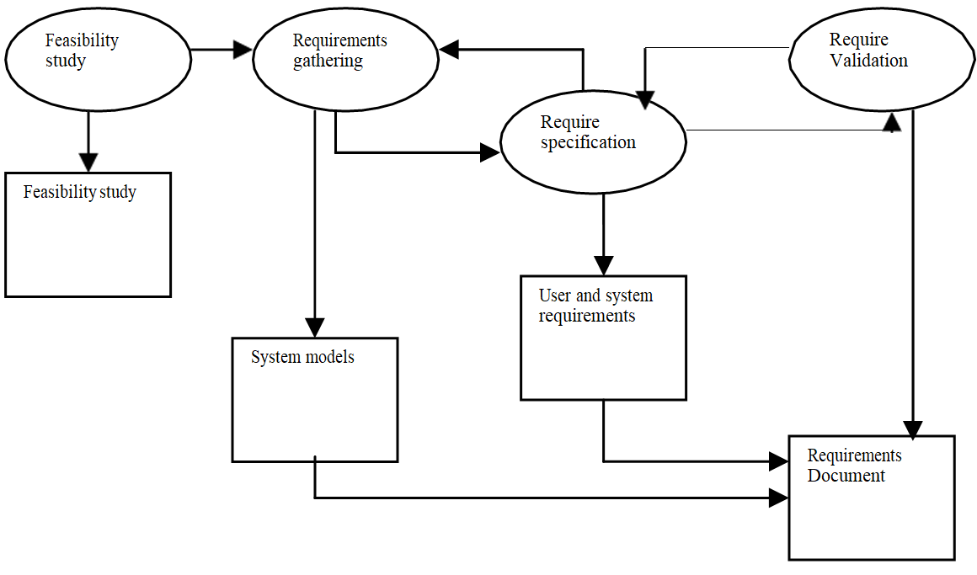
Requirements Engineering Process

Slide 7
Feasibility study
The Feasibility study is based mainly on the necessity of the proposed system
  in the organization and the
  domain information of the system.
This feasibility study helps the requirements engineers to answer the questions like
    Does the overall objectives of the organization is satisfied by the system?
    Can the system be developed within the proposed budget and timeline?
    Can the proposed system made to co-exist with the existing systems?

Slide 8
Requirements elicitation for software
Requirements elicitation is the process of gathering the requirements
In this process the technical professional in the organization,
  like software developers and
  the system engineers,
  work together with the users of the system and the customers
This process is useful in finding the problems that has to be solved.

Slide 9
Requirements elicitation for software
The problems include
  What the proposed system should provide?
  What are the expected services form the system?
  What are the required characteristics of the system?
  What are the required hardware and software constraints of the system?

Slide 10
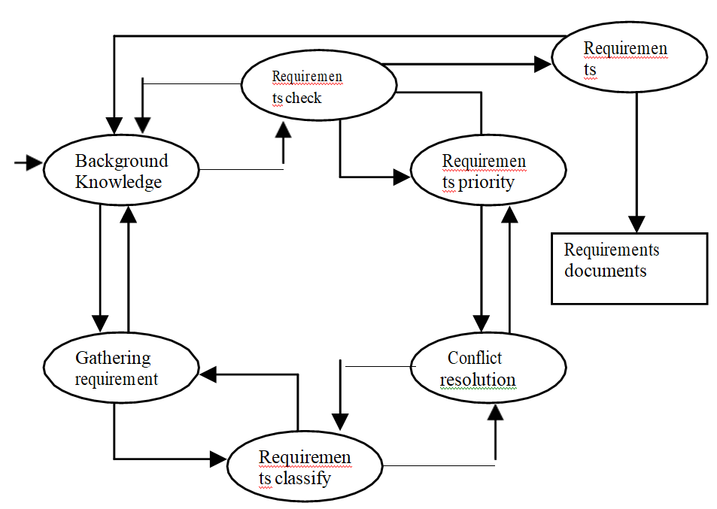
Requirements elicitation Process

Slide 11
Back ground Knowledge
The analyst must understand the back ground and the domain knowledge of the application that is being developed.
Example: If the system is developed for ATM, the developer should have some basic knowledge of how the ATM works.

Slide 12
Gathering the requirements
This is the activity of discovering the requirements by involving with the stakeholders and users.

Slide 13
Requirements classification
This activity includes the organizing of the requirements gathered from different sources.

Slide 14
Requirements conflict
This activity involves with the stakeholders and requirements engineers.
This is used to solve the problems in the requirements that contradict the organization and business rules.

Slide 15
Requirements Prioritization
Discovering the important requirements by interacting with the stake holders and organize them in to most priority order.

Slide 16
Requirements check
This activity involves checking the stake holder’s expectations on the system with the gathered requirements.

Slide 17
Requirements Elicitation techniques
  Interviews
  Questionnaire
  Social analysis
  Prototyping

Slide 18
Tomorrows class
  Requirements Elicitation techniques
  Software Prototyping
  specification

