Slide 1
Module II
Process Framework Models: Capability maturity model (CMM), ISO 9000.
Phases in Software development –
  requirement analysis
    requirements elicitation(Intelligent information) for software, analysis principles, software prototyping, specification.

Slide 2
Module II
CS308 Software Engineering and Project Management
Arunvinodh C
AP, CSE

Slide 3
Capability Maturity Model

Slide 4
Contents
CMM
Process Maturity Concepts
CMM Levels

Slide 5




What is CMM?
CMM: Capability Maturity Model
It is not a software process model/Software life cycle model
Developed by the Software Engineering Institute of the Carnegie Mellon University
CMM is used to bench mark the maturity of an organization software process.

Slide 6
What is CMM?
Describes an evolutionary improvement path for software organizations from an ad hoc, immature process to a mature, disciplined one.
Provides guidance on
  how to gain control of processes for developing and maintaining software
  how to evolve toward a culture of software engineering and management excellence.

Slide 7
Process Maturity Concepts
Software Process
  set of activities, methods, practices, and transformations that people use to develop and maintain software products
    (e.g., project plans, design documents, code, test cases, user manuals)
Software Process Capability
  describes the range of expected results that can be achieved by following a software process
  means of predicting the most likely outcomes to be expected from the next software project the organization undertakes

Slide 8
Process Maturity Concepts
Software Process Performance
  actual results achieved by following a software process
Software Process Maturity/Assessment
  extent to which a specific process is explicitly defined, managed, measured, controlled and effective
  implies potential growth in capability

Slide 9
SEI-CMM can be used in TWO Ways
Capability Evaluation
  Provide way to access the software process capability
Software Process Assessment/Maturity
  Used by an organization to improve the process capability

Slide 10
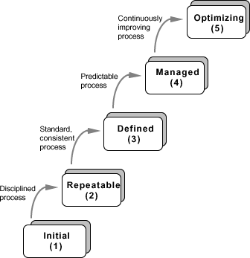
What are the CMM Levels?
(The five levels of software process maturity)
Maturity level indicates level of process capability:
Initial
Repeatable
Defined
Managed
Optimizing

Slide 12
Level 1: Initial
Initial : The software process is characterized as ad hoc, and occasionally even chaotic.
Few processes are defined, and success depends on individual effort.
  At this level, frequently have difficulty making commitments that the staff can meet with an orderly process
  Products developed are often over budget and schedule
  Wide variations in cost, schedule, functionality and quality targets
  Capability is a characteristic of the individuals, not of the organization

Slide 13

Level 2: Repeatable
Basic process management processes are established to track cost, schedule, and functionality.
The necessary process discipline is in place to repeat earlier successes on projects with similar applications.
  Realistic project commitments based on results observed on previous projects
  Software project standards are defined and faithfully followed
  Processes may differ between projects
  Process is disciplined
  earlier successes can be repeated

Slide 14


Level 3: Defined
At this level the software process for both management and engineering activities are well defined and documented.

Slide 15

Level 4: Managed
Work is quantitatively controlled
Software quality management
Quantitative process management
Management can effectively controlled the software development effort using precise measurement
At this level set a quantitative quality goals for both software process and maintenance
At this maturity level the performance of the processes is controlled using the statistical and other quantitative techniques and is quantitatively predictable

Slide 16
Level 5: Optimizing
Continuous process improvement is enabled by quantitative feedback from the process and from piloting innovative ideas and technologies.
Goal is to prevent the occurrence of defects
Data on process effectiveness used for cost benefit analysis of new technologies and proposed process changes

Slide 17
Summary
CMM
Process Maturity Concepts
CMM Levels

